Slide 1

SQL PROJECT
Market Analysis Insights

Slide 2
Objective
Understanding customer purchasing patterns
Analyze sales data to understand customer preferences and product performance.
Identify trends to optimize marketing and sales strategies.
Improve decision-making to maximize revenue generation.
Gain insights into customer behavior and preferences.
Analyze category-wise sales to inform inventory and pricing strategies.

Slide 3
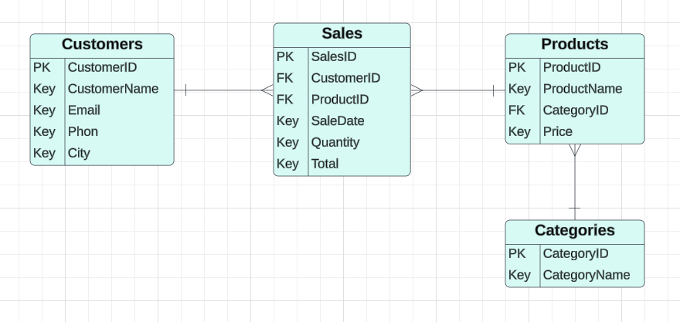
Entity Relationship

Slide 4
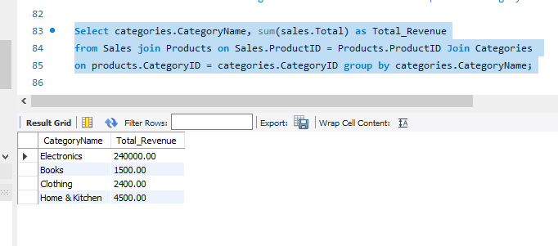
SQL Analysis With Their Output
1. What is the total revenue generated from sales for each product category?

Slide 5
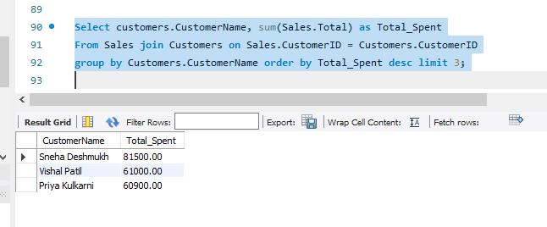
SQL Analysis With Their Output
2. Who are the top 3 customers based on total spending?

Slide 6
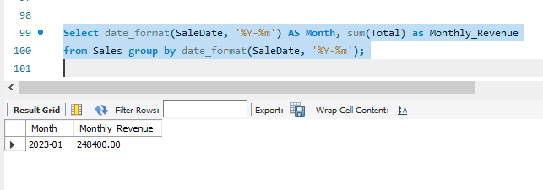
SQL Analysis With Their Output
3. What is the total sales revenue for each month?

Slide 7
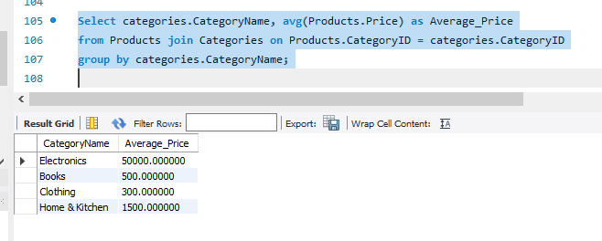
SQL Analysis With Their Output
4. What is the average price of products within each category?

Slide 8
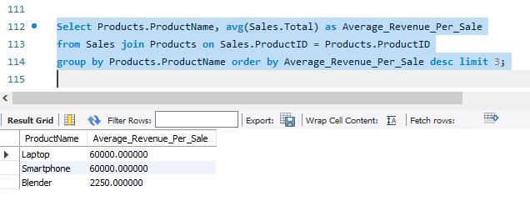
SQL Analysis With Their Output
5. Which products have generated the highest revenue on average per sale?

Slide 9
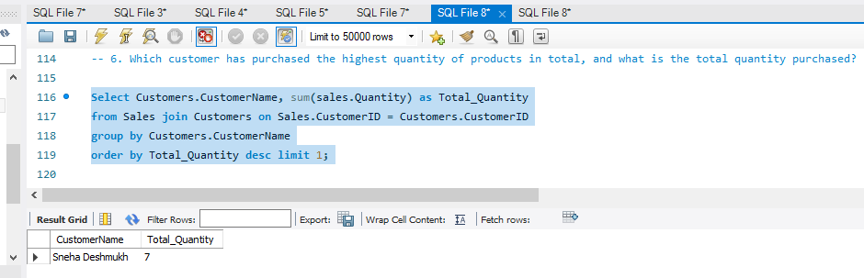
SQL Analysis With Their Output
6. Which customer has purchased the highest quantity of products in total, and what is the total quantity purchased?

Slide 10
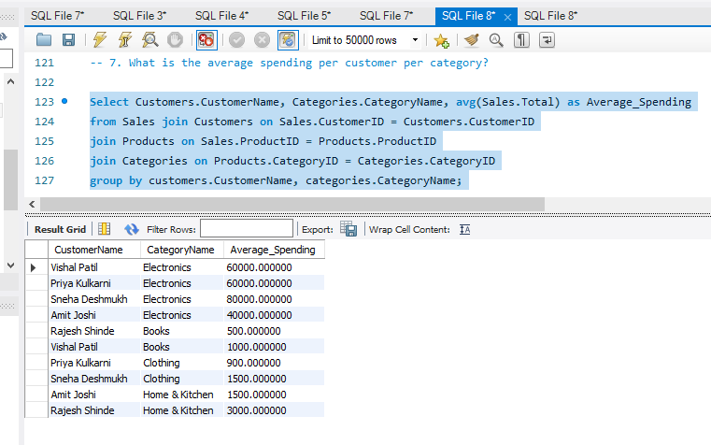
SQL Analysis With Their Output
7. What is the average spending per customer per category?

Slide 11
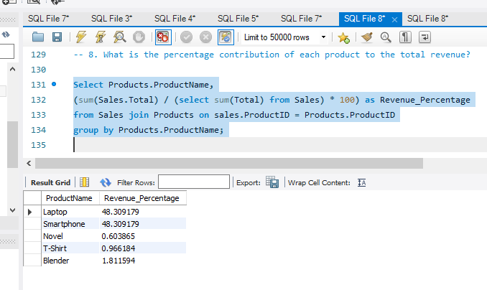
SQL Analysis With Their Output
8. What is the percentage contribution of each product to the total revenue?

Slide 12
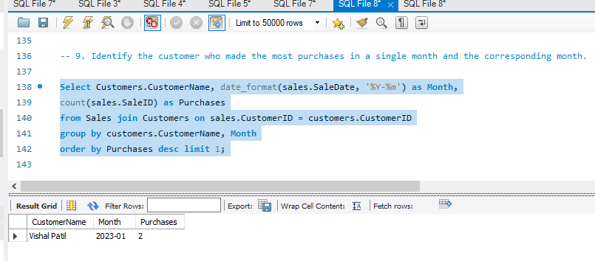
SQL Analysis With Their Output
9. Identify the customer who made the most purchases in a single month and the corresponding month.

Slide 13
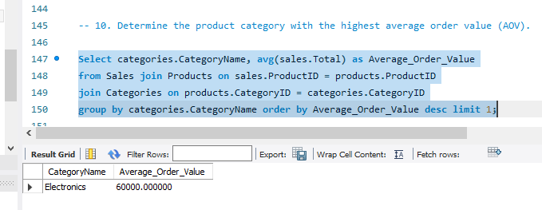
SQL Analysis With Their Output
10. Determine the product category with the highest average order value (AOV).

